Slide 1







We all have Mental Health
Please share 2-3 words that come to mind when thinking about the importance of mental health - personally and professionally.
Notes:
Mentimeter activity - word cloud - slide 1
Suggested Activity Time - 5 minutes
Welcome to all participants!
Please share 2-3 words that come to mind when thinking about the importance of mental health - personally and professionally. We invite you to add your ideas to our mentimeter (see the code in the chat box.)
We all have mental health - just as we all have physical health. Mental health is much more than the absence of mental illness.
Developing positive mental health is foundational to student academic achievement, effective life skills, and overall well-being.
Summary comments on why it’s important:
If our goal is to ensure that all students have every opportunity to reach their full potential and succeed personally and academically - all educators must have a basic understanding of mental health literacy
Ensuring equity is a central goal of Ontario’s publicly funded education system, as set out in Education for Tomorrow (2020)
Our schools need to be places where educators and students value diversity, respect each other, and see themselves reflected in their learning. It is particularly important to provide the best possible learning opportunities and supports for students who may be at risk of not succeeding.
Mental health and well-being is a complex topic and may be personally challenging for staff depending on their circumstances. Effective leaders lead by example. When you model self-care and show personal resiliency, others follow your lead – staff and students. It is a powerful way to promote wellness.
Source: graphic

Slide 2

Mental Health and the Tiered Approach
to Support all Students
Supporting Student
Mental Health
for Administrators - Webinar #1 of 3
Notes:
Facilitator Introductions
Welcome to the first of three webinars designed to support principals and vice-principals in creating Mentally Healthy schools in Ontario. These webinars are hosted by ADFO, CPCO and OPC - in partnership with School Mental Health Ontario.
This webinar has been designed to be interactive. There will be opportunities for self reflection - and there will be opportunities for sharing practices. It is our hope over the next hour we spend together to build a community of lead learners who are open and reflective to build knowledge, skills and practices together.
The tools and resources featured in this webinar are relevant to all schools, including bricks and mortar as well as virtual contexts.
Graphic

Slide 3
A Mental Health Check In
You Matter.
Notes:
Mentimeter Activity – Slide 2
Suggested Activity Time - 2 Minutes
Use a GIF, an emoji, a meme, or just a word to share with our group how you are feeling.
So….Why Do we do Feelings Check ins?
A key SEL competency is self-awareness and it starts with students being able to identify how they feel.
A daily feelings check-in helps all of us learn to recognize different emotions and also the intensity of our emotions. We can't manage a feeling if we can't recognize it.
Checking in normalizes feelings. When we do check-ins with students, we help teach students to recognize that all feelings are okay. It then opens up the conversation that how we handle those feelings makes all the difference. Identification and management of emotions is a component in social emotional learning as we help students to gauge emotions.
Encouraging your staff to implement regular “Check ins” with students - communicates that how everyone feels is important. It is a simple daily task to do that shows students that we care, you matter, we want to listen, and we are here to support individual needs.

Slide 4
Land Acknowledgement (Toronto)
I acknowledge that I am on the traditional territory of nations within nations including the Anishnabe, the Ojibwe and the Michi Saagiig. This land has been, and continues to be home to many diverse First Nations, Inuit and Métis peoples.
I would like to acknowledge the enduring presence of Indigenous peoples on the lands on which I gather with you today across Ontario and I thank the past, present and future caretakers of this land. I am grateful to have the opportunity to work and learn on these lands in a community of sharing.
As users of the land, be it for pleasure or utility, we must continue to work to keep it clean and use it with care so that generations to come can also continue to benefit from the land.
Notes:
Suggested Activity Time for the personal story from facilitator -3 minutes
Each presenter in the webinar needs to share a sentence(s) acknowledging how they connect to the land they are on - personal connection.

Slide 5

Good and loving God,
We thank You for creating the world in all its beauty.
We thank You for memory, which enables us to build on the experiences of the past;
For imagination, which admits us to a wider world than we could have otherwise known;
and for foresight, by which we plan for the future.
Bless this unseen work that we do on behalf of our students who,
Through their Catholic education,
will strive to make a difference in the world.
We ask this in Your name.
Source: Joseph P. Shadle

Slide 6
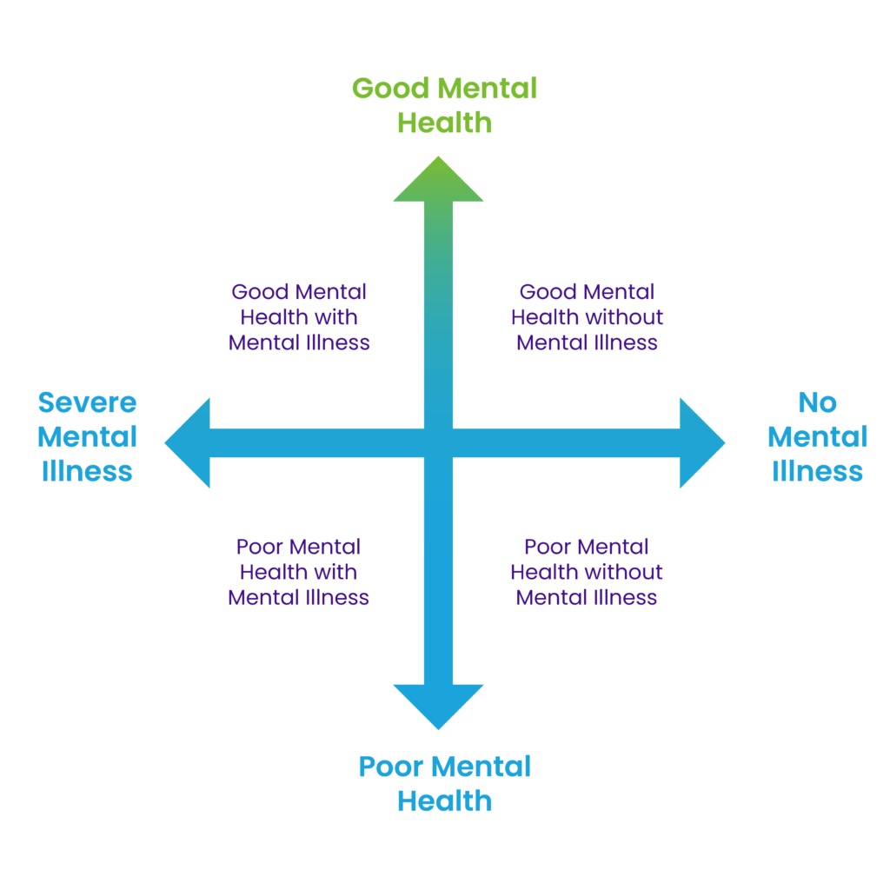
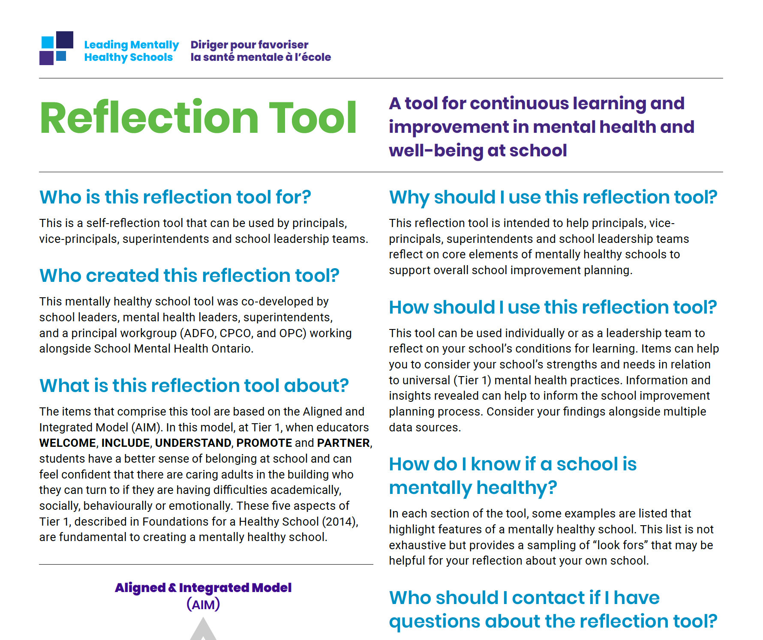
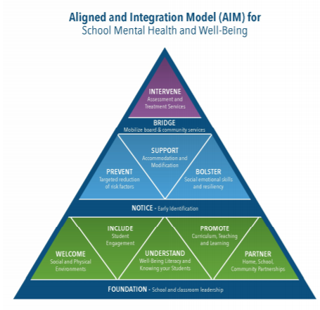
Learning Goals
Gain a deeper understanding of
the role schools play in supporting mental health
creating conditions for MH and well-being
mental health as a dual continuum
the Aligned and Integrated Model (AIM)
resources to support school improvement planning
Notes:
Facilitator to read the learning goals listed on the slide.
A leader’s role at school relates to instruction and learning, however, without healthy minds, learning and teaching is a difficult task.

Slide 7

Today’s Webinar = Active Learning
Share an idea/thought
Reflect/journal your private thoughts
Notes:
Throughout our webinar please take note of these 2 emojis. They act as the key to our built-in active learning key moments.
When you see the emoji on the left on a slide, we encourage you to SHARE an idea or thought to our discussion - sometimes through the chat box, sometimes through Mentimeter - we will share the directions at the time.
When you see the emoji on the right side of the screen here - we encourage you to take a brief moment to privately write down or journal notes/key ideas/questions for reflection at a later time.
As leaders, a tool that helps us refine our leadership skills is The Ontario Leadership Framework.
Next up we will take a look at the leadership tools and their connection to the work we do to lead mentally healthy schools.

Slide 8
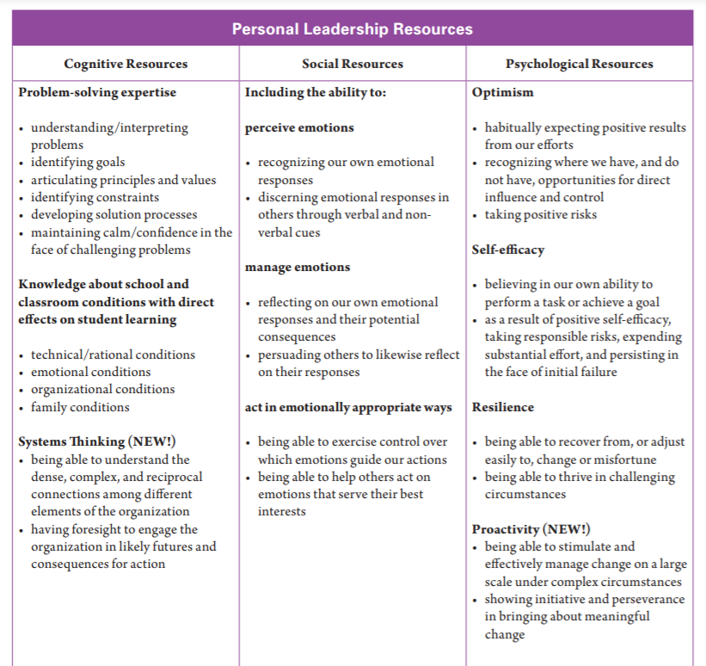

The Ontario Leadership Framework
Setting Directions
Building Relationships and Developing People
Notes:
Mental Health and well-being is our priority. Setting direction and building a shared vision is an important aspect of your leadership role. We all need to work together. Principals and vice-principals must work collaboratively with students, staff, parents and other stakeholders to develop an overall sense of purpose and understanding for the work being done in this area. Developing trusting relationships with all stakeholders and leading with compassion and empathy, is an essential part of creating positive, healthy, safe learning environments for our students to thrive.
The Ontario Leadership Frameworks highlights the Personal Leadership Resources. These leadership resources are the interpersonal skills that help us work effectively with people. Within the category of the Social Resources, the importance of leaders being able to perceive emotions, manage emotions and act in emotionally appropriate ways is recognized. The Personal Leadership Resources (PLRs) are a skill set each leader brings to the table to build and enhance relationships that create a sense of belonging and wellness for our students.
Important PLR’s are also identified in the psychological resources category of the framework.
Optimism, self-efficacy, resilience and proactivity are highlighted as key leadership resources.
These skills help us recognize where we have direct influence.
Modelling is a key leadership practice. Prioritizing self-care and believing in ourselves and our abilities will help us meet our set goals for creating positive mentally healthy schools.
Schools are an excellent place to promote and protect mental health.
Ensuring equity is essential to improving student achievement and promoting student and staff well-being.
Being Equity minded as a school leader is critical.
Let’s now take a look at some tips on HOW to be equity minded…

Slide 9

How to be EQUITY-minded
Understand
Intersection between equity and mental health
Systemic oppression, colonization, racism, privilege
Culturally relevant and responsive practices
Biases and privilege
The degree to which all students are served
What do you currently have in place to ensure that all students, families and staff feel that they matter?
Notes:
Suggested Activity Time - 1 minute
As school leaders, here are a few key ideas- that will help you to be equity-minded and create equitable practices and opportunities within your schools.
•Understand the intersection between equity and mental health. For example- People often experience both mental health issues and addictions and additional inequities such as transphobia, racialization, or poverty simultaneously. Intersectionality creates unique experiences of inequity and mental health that poses added challenges for the individual, community and health systems level.
•Educate yourself about systemic oppression, racism, privilege. Look for ways to dismantle powerful unexamined ideas that perpetuate discriminatory practices.
•Ground your work in culturally-relevant and responsive practices. For example, "How can I incorporate Indigenous ways of knowing into my current pedagogical practice?"
For example, we can support our mental health and well-being by looking at our cultural teachings and taking care of ourselves holistically as depicted in the 4 areas of the Indigenous Medicine Wheel (see slide 9)
•Check your own biases and privilege. For example - "How comfortable am I talking about racism?", What are your anti-racism strategies?
•Consult with humility and take a learning stance when considering programming that is designed to support a marginalized population for example LGBTQ2S+, Black, Ingenious students.
•When you introduce a new mental health initiative, consider the degree to which all students are served, and who may need something more or different. (consider your most vulnerable students here)
Pause and Think - and we invite you to jot down your own ideas...What do you currently have in place in your school to ensure that all students, families and staff feel that they matter - that they are included - that they belong?
As school leaders, the promise of mental health can be realized through a firm commitment to equity and inclusion. By addressing stigmas and the barriers that exist in our schools, be it structural, knowledge, quality, equity or systemic in nature, we can support our students on their mental health journey.

Slide 10

Mental Health and Well-being and the Medicine Wheel
Physical
Exercise
Eating Nutritious Food
Gathering Medicines
Arts
Mental
Indigenous knowledges reflected in the school
Learning something new
Emotional
Getting enough Sleep
Connecting with friends
Journaling
Spiritual
Smudging
Cultural Teachings
Talking to an Elder
Connecting to Community
Notes:
The Medicine Wheel is an important symbol for many Indigenous peoples that carries teachings about the stages of life, seasons of the year, elements of nature, animals, ceremonial plants and the aspects of being like the physical, mental, emotional, and spiritual (Katz & Lamoureux 2018)
There are opportunities to learn from Indigenous peoples.

Slide 11

Honouring Perspectives
Mental Health and Well-Being
Notes:
Honouring Perspectives
Cultural safety is individual and is guided by learners in a way that feels safe to them.
By honouring cultural teachings it creates a welcoming environment for Indigenous students in the classroom and all other learners.
By honouring Indigenous perspectives within the classroom, all learners benefit.
These guiding principles apply to Indigenous students, but the same ideas should be extended to other cultural perspectives such that ALL students feel welcome and valued. We know that black, Indigenous and other marginalized communities are impacted by systemic racism and colonial structures in education, healthcare and other areas of society. We can support mental health and well-being of students by looking at cultural teachings and taking care of ourselves and each other holistically.
Please keep these facts in mind when welcoming various communities.

Slide 12
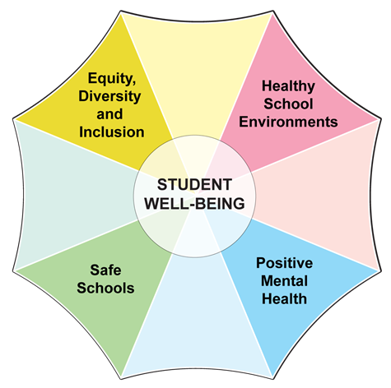
Thinking About our Role as School Leaders
Student Achievement is well-being.
Well-being is student achievement.
Andy Hargreaves
Notes:
Suggested Activity Time- 2 minutes
As school leaders we have been given a unique opportunity to impact, educate and care for the students in our schools. Andy Hargreaves says “that student achievement is well-being and that if we think long and hard about it “well being is student achievement.” “Students cannot achieve academically if they don’t feel safe or welcomed at school, if their mental health is at risk and if they don’t have the tools or motivation to adopt a healthy, active lifestyle, both inside and outside of school. https://collections.ola.org/mon/30005/334837.pdf
Student Well Being is at the centre of this umbrella and includes Safe Schools; Equity, Diversity and Inclusion; Healthy School Environments and Positive Mental Health.
Promoting positive mental health is a key component of student well-being.
Fostering learning environments that consider the components of well being combine to create opportunities for positive mental health.
(source - https://smho-smso.ca/school-and-system-leaders/your-role/)
It is our responsibility as Principals to create the conditions in our schools that build communities of practice which encourage students to develop healthy minds and healthy relationships. School leaders help to create the conditions needed for respectful, safe, inclusive and accepting learning environments. Relationship building and knowing our staff and students are key aspects. It is our responsibility to identify and work collaboratively to eliminate discriminatory practices, systemic barriers and bias from our schools and classrooms to support the potential for all students to succeed.

Slide 13
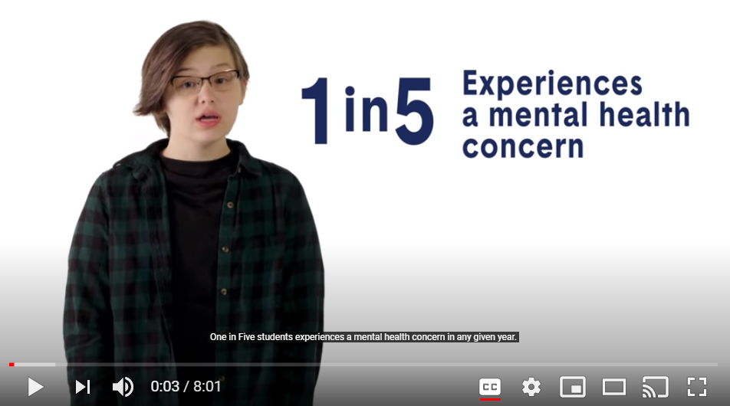
Supporting Students’ Mental Health
Research
VIDEO
Source: Ontario College of Teachers
Professional Advisory – Supporting Students’ Mental Health
Notes:
Research indicates there is a clear relationship between positive student mental health and school achievement.
When students are preoccupied with emotional concerns they cannot be fully available for learning.
Let’s take a look at some of the research on student mental health - in this brief video clip from OCT. The video is 8 minutes in length - we will watch just the first minute.

Slide 14

Schools play an increasingly important role in promoting mental health for all students to inspire hope, belonging, meaning and purpose. School leadership makes a difference.
Notes:
Facilitator read the statement on the slide - Schools play an increasingly important role in promoting mental health for all students to inspire hope, belonging, meaning and purpose.
School leadership makes a difference.
Through research and consultation with Ontario school and system leaders, School Mental Health Ontario has identified 10 top organizational conditions for us as leaders to consider and reflect upon, let's take a look…

Slide 15

Top 10 Organizational Conditions (page 1 of 2)
1. Visible commitment from leaders
2. Active Mental Health Leadership Team
3. Clear and focused vision
4. Strong communication and shared language
5. Routine assessment of need and capacity
Notes:
Mentimeter – slide 3
Suggested Activity Time - 2 minutes
As leaders, we set the conditions for educators to - promote mental health and SEL - and we also set the conditions so that educators notice when a student may be struggling and connect students with supports. This slide shows us the first 5 of 10 top organization conditions for educators.
Let’s take a closer look at #1 and #4 on the slide here -we want you to think about your leadership actions specific to your visible commitment and the shared language used across your school.
What are the visible indicators for your staff, your students, your parents that show you are strongly committed to supporting student mental health at your school?
(add your ideas to the mentimeter – precede your comment with the word staff, students, parent/caregiver so that we know which group the indicator is intended for)
How do you build shared language for mental health and well being in your school? How could you use this resource in your school?
Source - https://smho-smso.ca/school-and-system-leaders/learn-more/mental-health-leadership-strategies/set-the-stage-with-organizational-conditions/

Slide 16

Top 10 Organizational Conditions (continued)
6. Standard processes and protocols
7. Systematic professional learning and training
8. Ongoing mental health strategy and action plan
9. Meaningful engagement and collaboration
10. Ongoing quality monitoring
Notes:
7. Systematic professional learning and training
What are the professional learning opportunities you provide to ensure all staff are ready, willing and confident to support student mental health?

Slide 17


Mental Health Literacy and The Dual Continuum Model
Mental Health Literacy Video
How might you use this video with your staff?
Notes:
Suggested Activity Time - Video - 5 minutes
Please note the emoji here - this marks time we have built in for your personal quiet reflection and writing.
As we work to improve our knowledge in mental health literacy - you may find that some people confuse the terms mental health and mental illness.
This brief video is one that you could share with your staff to learn how to shift your language to help with understanding - and improving our mental health literacy.
As we view this video - please consider….So what? Now what? - Share a few comments, that reflect - how you might you use this video with your staff? (use in the chat box)
WATCH VIDEO - link video in the chat group
On the right side of the slide is the Dual Continuum Model - from School Mental Health Ontario. While you might imagine mental health on one side of a continuum, and mental illness on the other, it is probably more complex than that. This dual continuum model allows a more comprehensive way of looking mental health and mental illness
Mental illness and Mental Well Being (or positive mental health) are 2 different concepts - not opposite - they are separate - yet interconnected.
You can have a mental illness, and still have good mental health (just like you can have diabetes, and still feel healthy). The key is to know how to manage your symptoms and to live fully, in spite of the challenges you face.
To understand how we can help and guide our students to have positive mental health - the AIM Model for the tiered system of support can help us design and monitor positive mental health work in our schools...let’s take a look….

Slide 18
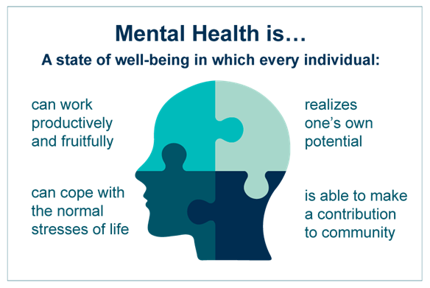
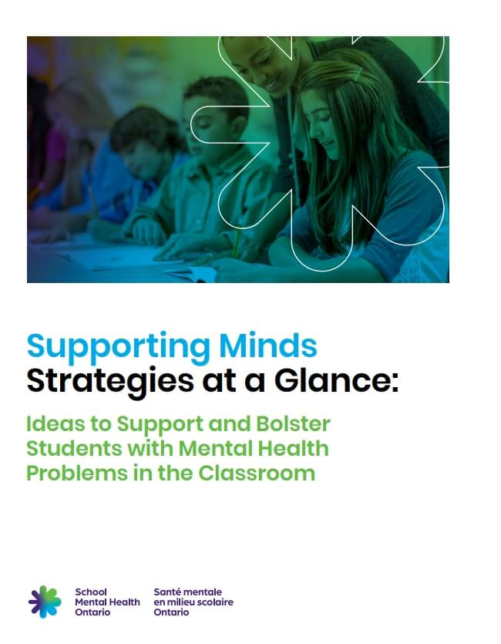
Resources to Support School Leaders in Leading
Mentally Healthy Schools
Notes:
Facilitator to read MH definition from slide - Mental Health is….
In addition - as a definition of MENTAL HEALTH - The World Health Organization stresses the positive dimension of mental health through their definition of mental health...
“Health is a state of complete physical, mental and social well-being and not merely the absence of disease or infirmity.”
Shown on the right side of the slide is a resource that can help in your programming and school wide planning to further support student mental health.
Supporting Minds - Strategies at a Glance
As Principals, you likely have used the Ministry document - Supporting Minds. SMH-ON has a support document entitled Supporting Minds - Strategies at a Glance (highlight resource in the split screen, scrolling)
Supporting Minds - Strategies at a Glance can be used as a resource during your in-school team meetings. Some students will require additional support because of stressful circumstances, vulnerabilities, or experience of trauma. When your school staff recognize that a student is struggling - have very specific information for support of mental health problems. Some students may need educational supports guided by an IEP - this document can assist a school team in selecting and documenting strategies for success.

Slide 19
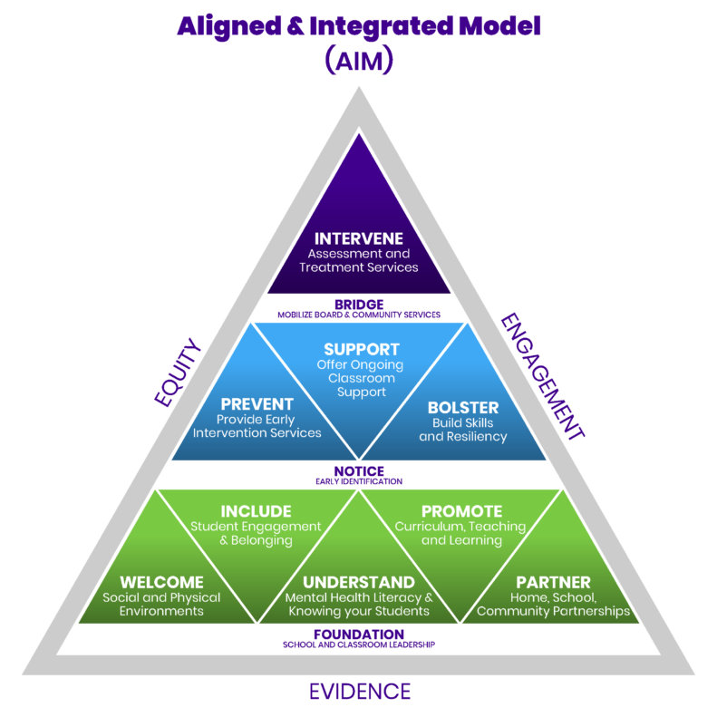

Think in Tiers and Focus on The Positive
Info Sheet for Supporting Minds
Overview of Mental Health and Well-Being at School
Text here
Notes:
The Aligned and Integrated Model (AIM), outlines a multi-tiered system of support for Ontario schools, and emphasizes that most of the work of schools is, or should be, focused on tier 1 (mental health promotion) and tier 2 (prevention) services.
This model is designed to help with your school improvement planning. When you think in tiers, you can effectively design and monitor mental health services for your school.

Slide 20
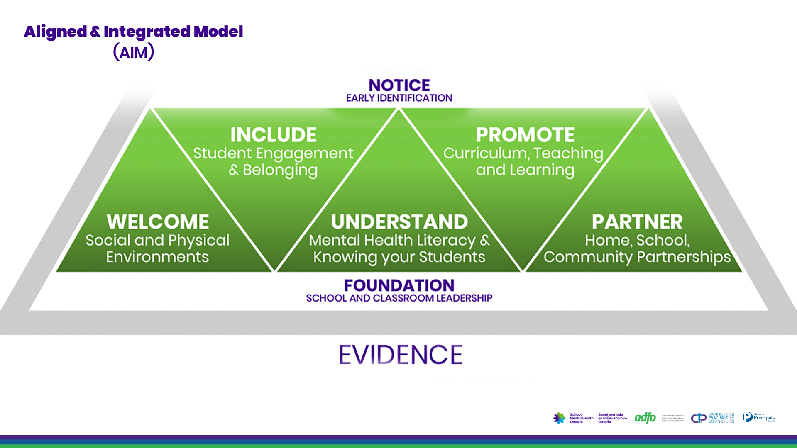
Notes:
TIER 1 - the foundational components for school and classroom leadership are shown here in green - are good for ALL students. This is the foundational everyday work you and your staff do to welcome and include students, to understand them and build knowledge of mental health, to promote mentally healthy habits and to partner with parents, students and other staff to create a supportive environment. Most of the mental health work in schools is at this level.

Slide 21
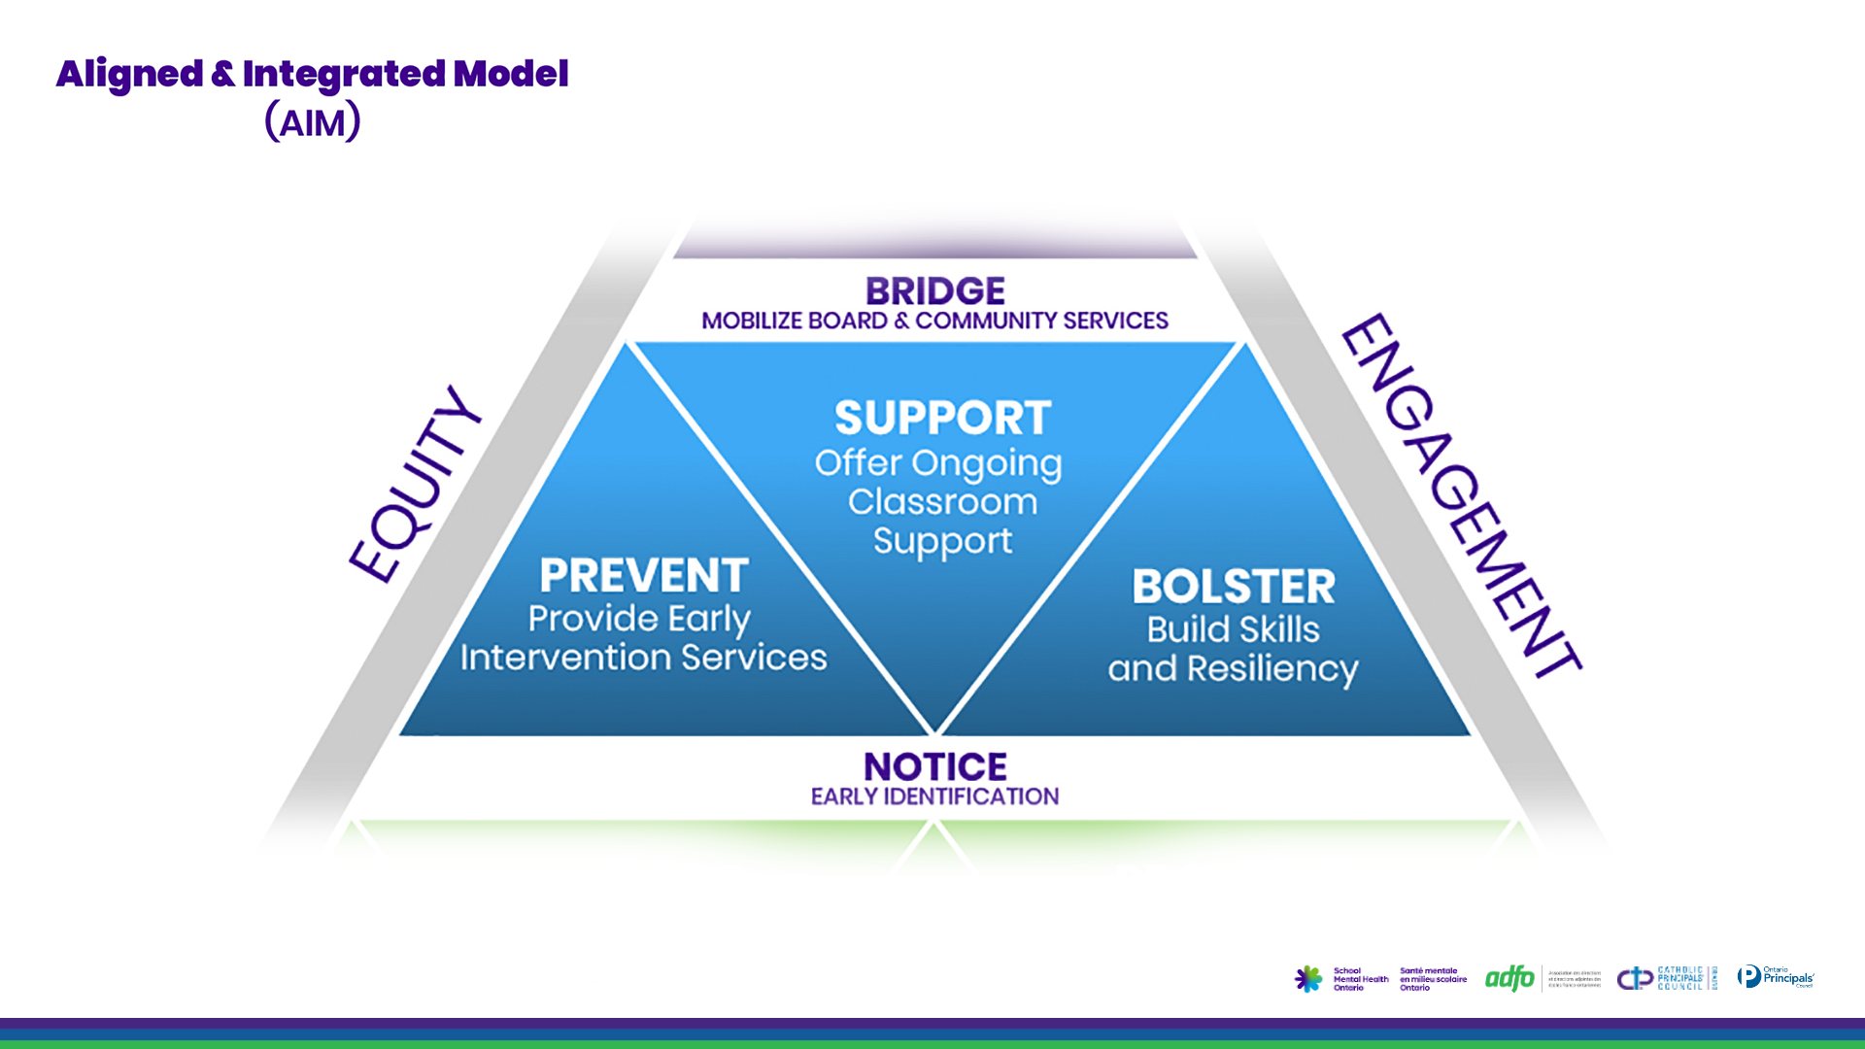
Notes:
TIER 2 - the blue section - is necessary for SOME students. Tier 2 focuses on prevention and early intervention. In every class and school, there will be some students who may need additional support in the classroom. You can help by reinforcing skills and working to remove barriers to learning. At this level, school mental health professionals and others with specialized skills provide intervention services, like structured psychotherapy, at this level.

Slide 22
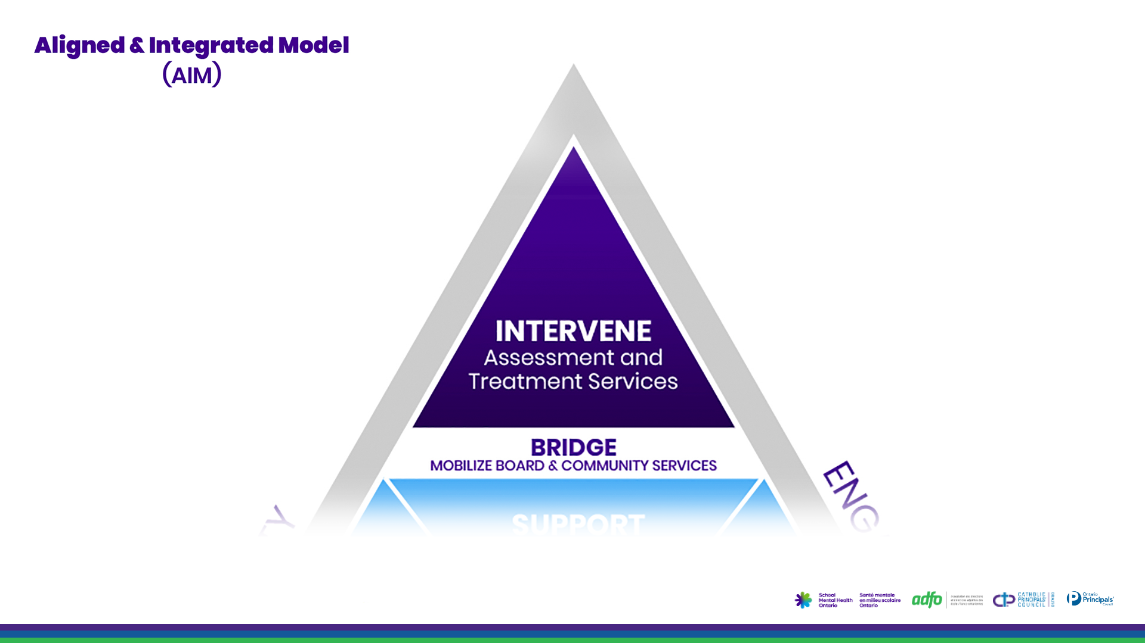
Notes:
TIER 3 - the purple section at the top - is essential for FEW students. Tier 3 services support students requiring more intensive assessment and intervention services. Although it will always be necessary for schools to provide some level of tier 3 service (because students cannot or will not access outside supports, and to manage crisis events as they arise), our role in schools is to help students to access appropriate community or health services and to provide needed ongoing care while students are at school.
Schools are uniquely positioned for mental health promotion, early identification, prevention, and early intervention services. While we have a supportive role to play in crisis management and can provide accommodations and classroom strategies for students struggling with a mental illness, we do not have responsibility for intensive mental health services.
We need to work in partnership with community and health partners, as part of the system of care. Our priority contribution is upstream promotion and prevention.
Many of these practical ideas that are classroom ready can be shared with your staff through the 2 page resource linked on the right of the slide here called Overview of Mental Health and Well-Being at School.
Let’s now take a look at a SMHO resource that allows school teams to reflect on core elements of mentally healthy schools to support overall school improvement planning - and ensure social emotional learning is intentional and purposeful

Slide 23

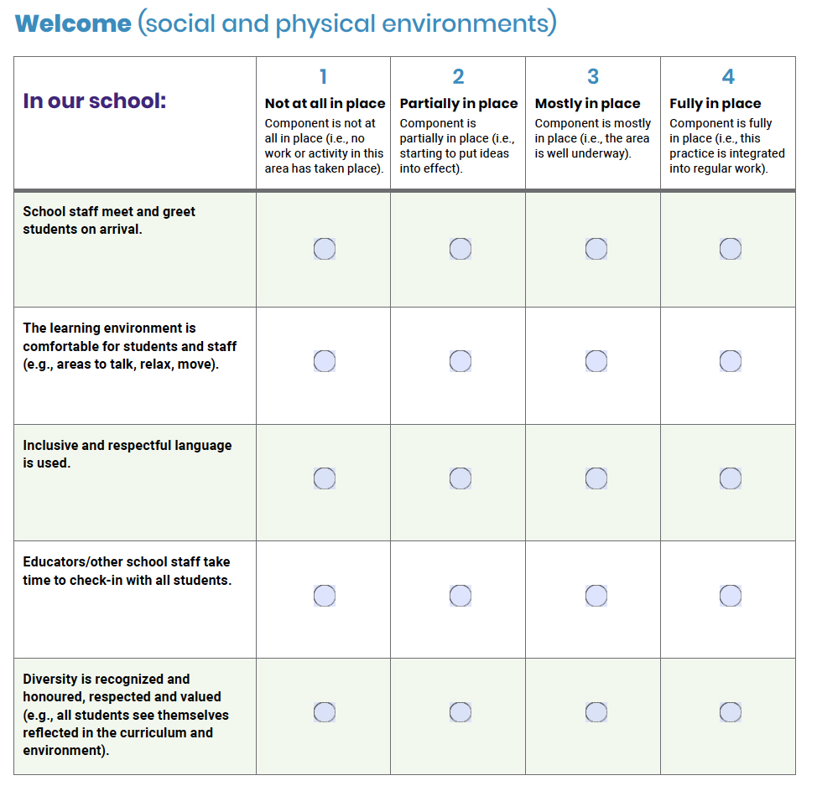
Leadership
Look fors
Notes:
Leading Mentally Healthy Schools Reflection Tool - is for you as Principals. This reflection tool will help school teams reflect on core elements of mentally healthy schools to support overall school improvement planning - and ensure social emotional learning is intentional and purposeful
In each section of the tool, some examples are listed that highlight features of a mentally healthy school.
This list is not exhaustive, but provides a sampling of "look fors" that may be helpful for your reflection about your own school.
This slide highlights a few planned pieces that would be considered under the WELCOME aspect of Tier 1.
For example, one of the ways to honor Indigenous knowledge and to create a welcoming environment for Indigenous students is to learn more about different cultural teachings from Indigenous peoples. For instance, the Seven Sacred teachings is an Anishinaabe teaching that shares important life lessons: Love, Respect, Wisdom, Courage, Bravery, Honesty, Humility and Truth.

Slide 24
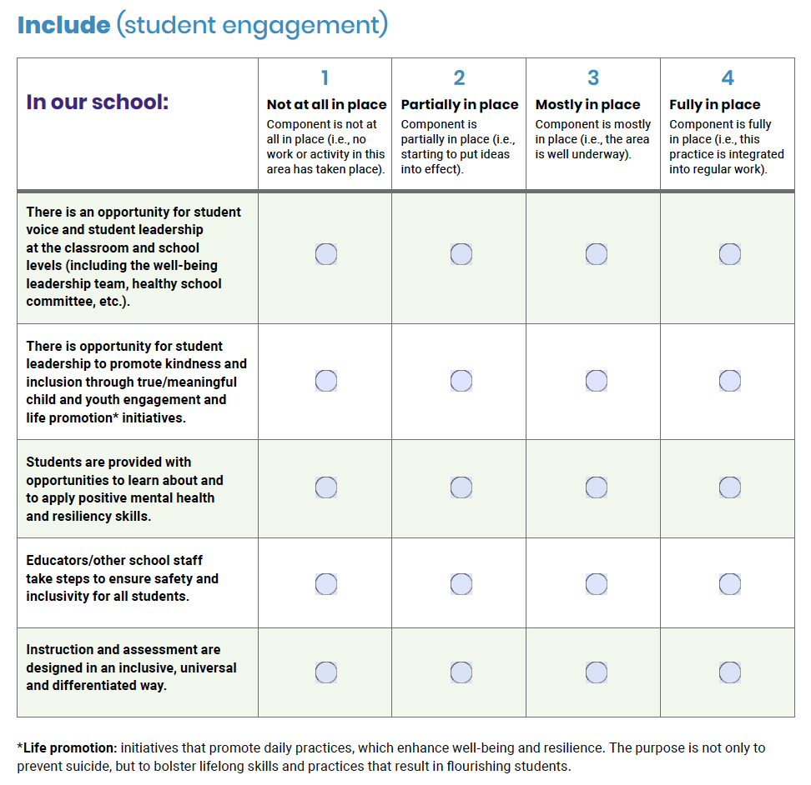
Student Engagement
Use the chat box on the screen to answer this question.
How do students participate in decision making and leadership in your school?
Notes:
Suggested Activity Time - 1 minute
Read through these student engagement look fors - for the INCLUDE component of tier 1 thinking and planning.
Student voice is a large part of student engagement.
Giving students voice and involving students in school decision making encourages participation in classroom and community life. Involving students in decisions that affect them either through formal structures and processes or informal processes as individuals, is key. Intentionally creating these opportunities for students is important.
Take a moment to identify some of things you do to encourage student voice in your school.
Please add your ideas into the chat box.

Slide 25
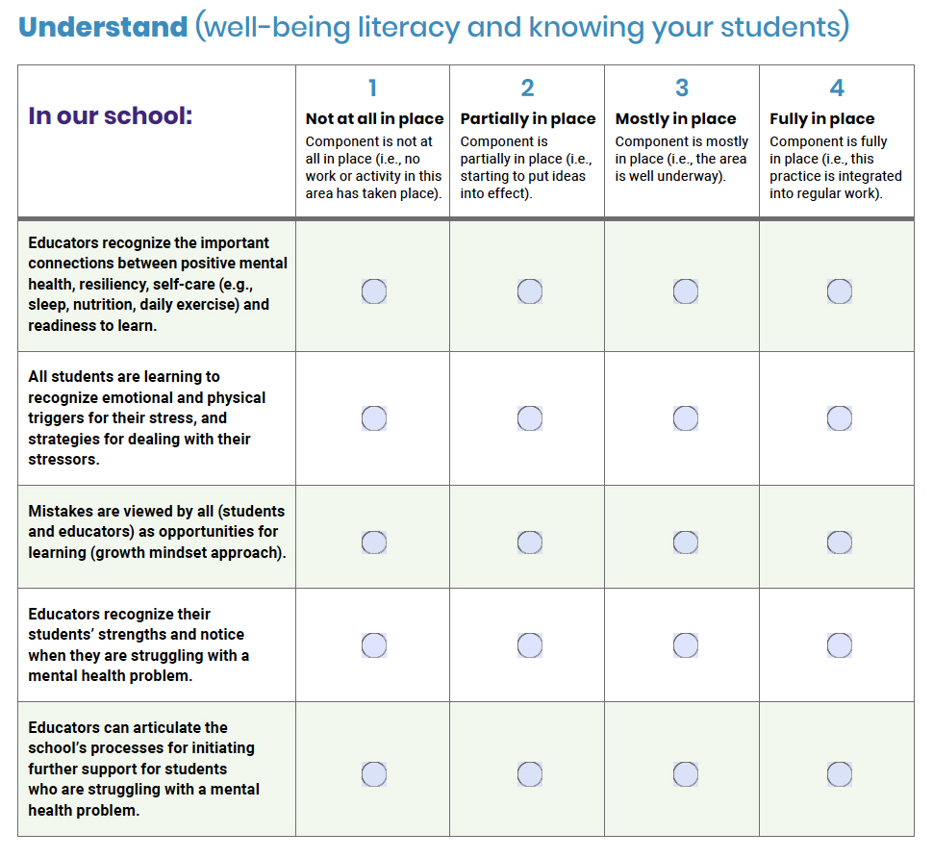
Reflection Questions
How are mistakes viewed by
the stakeholders in your school?
As a school leader, how do you encourage the use of mistakes to become opportunities for learning?
Mistakes are viewed by all (students and educators) as opportunities for learning (growth mindset approach).
Notes:
Suggested Activity Time - 1 minute
These are the” look fors” - for the UNDERSTAND component of Tier 1.
Look at the third “look for” on the chart.
Let’s use this an an example to think about mistakes.
Mistakes are viewed by all students and educators as opportunities for learning, which is the growth mindset approach.
This “look for “ can be further explored in the Supporting Minds - Strategies at a glance resource - lets take a look at the snapshot on the next slide.

Slide 26

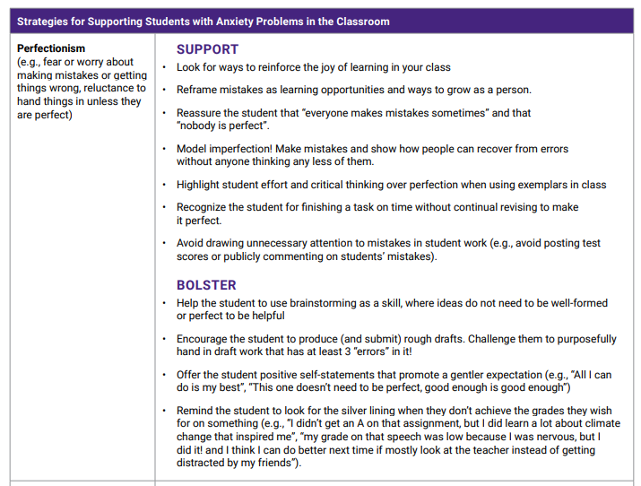
Notes:
Supporting Minds - Strategies at a Glance - is the resource pictured here on the left. It offers ideas for helping educators in the classroom to SUPPORT by offering accommodations and modifications to help students to be successful in the classroom - and to BOLSTER by helping to build skills and strategies for supporting mental health
When we are supporting a student struggling with perfectionism we can go to page 7 and look under the heading Strategies for Supporting Students With Anxiety Problems in the Classroom for some support and bolster ideas.
Perfectionism is discussed here and described as fear or worry about making mistakes or getting things wrong, reluctance to hand things in unless they are perfect.
In this example - Supporting Minds - strategies at a glance - provides guidance on making mistakes. See the slide shown here for some ideas.
As a school leader, how do you encourage the use of mistakes to become opportunities for learning.Take a moment to pause, think and write down your thoughts.

Slide 27
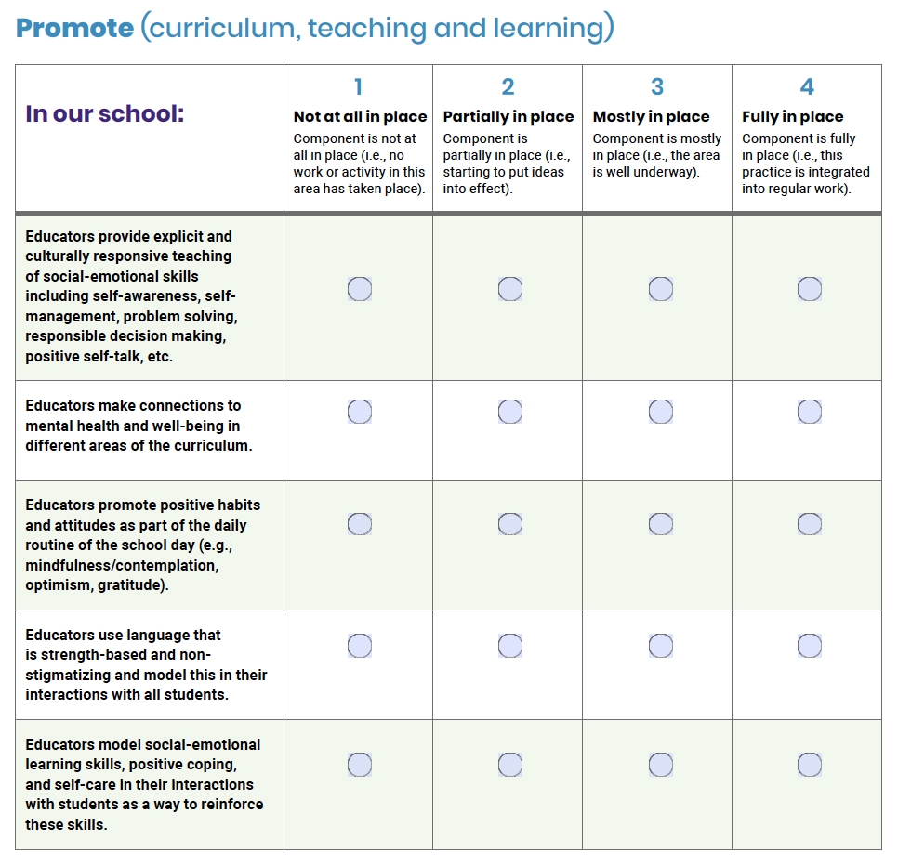
Reflection Questions
What are you seeing and hearing that is evidence that your school community is committed to promoting mentally healthy classrooms/school?
What is the evidence in your school that staff value and teach learning skills and work habits?
Notes:
SUGGESTED ACTIVITY TIME - 1 minutes
Valuing the learning skills and work habits found on the report card provides entry points for SEL growth for many students.
Using the report card learning skills and work habits section as a point of reflection and focus for goal setting, helps students to develop positive attitudes and habits.
Take a moment to reflect on these ideas.
Then take a look at the reflection questions.
Jot down your thoughts.

Slide 28
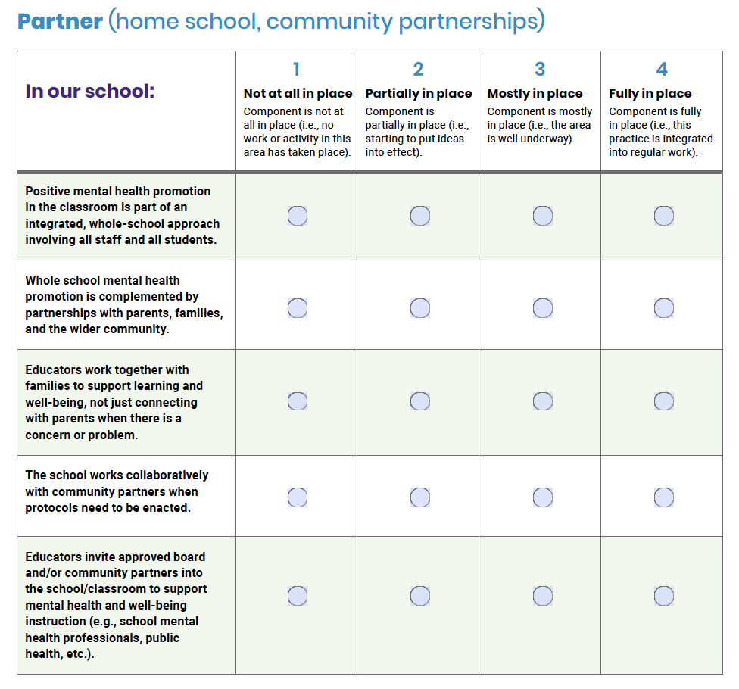
How do you engage your families and community partners to promote and support positive mental health and learning in your school?
Notes:
Suggested Activity Time - 1 minute
A whole school approach to mental health includes many things. Mental health is everyone’s responsibility All stakeholders in the school must be involved. That includes students, teachers, families and the community at large. In particular, we really need to work to build partnerships with families in order to move this agenda forward. Our traditional approach to parent involvement has to change, we need to be connecting with families regularly not just when there is a problem. The OLF Framework highlights the fostering of genuine, trusting relationships as a key leadership practice. Respectful, ongoing communication and transparency are essential to encouraging parent engagement. Helping staff understand that parents are partners in a student’s education, in both academic achievements and social emotional development, is part of our role as school leader. Parents need to be invited into a reciprocal partnership with the school, where we share the responsibility for student success. When we involve parents, they are more supportive because they understand what is happening in the classroom and our school. By understanding each other’s perspectives and experiences makes us more effective.
I invite you to now take a moment now, pause and think and write:
How do you understand and engage your families unique lived experiences and, community partners to promote and support positive mental health and learning in your school?

Slide 29



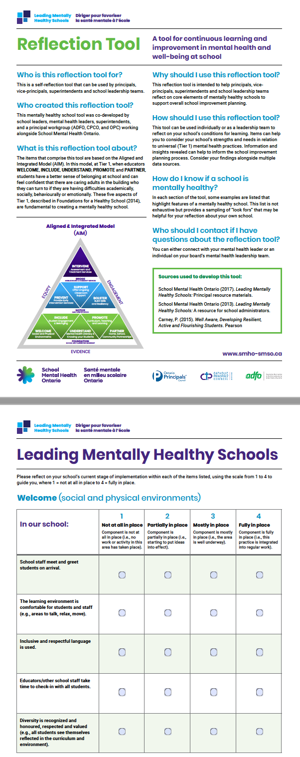
Notes:
Leading Mentally Healthy Schools Reflection Tool: A tool for continuous learning and improvement in Mental Health and Well-Being At School
The document is scrolling on screen here for you to take a look.
The questions are provided to you on a fillable form.
And… at the end of the Leading Mentally Healthy Reflection Tool is a fillable chart that helps you and your school improvement team think about and plan next steps.
https://smho-smso.ca/blog/online-resources/lmhs-reflection-tool/
Scrolling document (PPT animation)

Slide 30
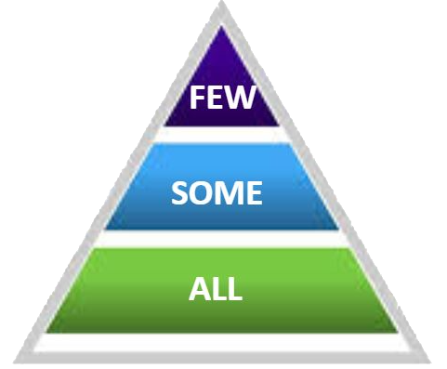
PROUD MOMENT!
REFLECTION
Think in Tiers...
SHARE something that you have intentionally done to help lead a mentally healthy school?
(for ALL, for SOME, for FEW)
Notes:
Suggested Activity Time - 3 minutes
Mentimeter – slides 4, 5, 6
David Weinberger said - “The smartest person in the room, is the room.” Let’s use the the room - our webinar room - to gather ideas of specific, intentional and purposeful actions that you have taken (or are considering doing - given your learning here today) to help lead a mentally healthy school. We have an interactive board set up to gather your ideas. Please do click on the link in the chat box to contribute to our PROUD MOMENT board.
Here are a couple examples for each tier…
Good for ALL - We use our school mascot in our language for everything we do to help build a sense of community - and a sense of belonging.
Necessary for SOME - Our division lead teacher and our CYW work together to plan for and lead a small support group for students with similar needs - as prevention and early intervention.
Essential for FEW - Our school attendance counsellor sees students on an individual basis and runs a couple of small groups to provide the additional space and time to help teach and reinforce healthy coping habits.
Thank you to all participants for sharing your practical ideas and we hope that you can use this shared Proud Moment board with your school teams for further reflection.

Slide 31
In monitoring your school-wide mental health literacy initiatives, what evidence (conversations, observations, products) will you be collecting?
Monitoring
Develop shared understandings
Here’s What – analyzing evidence
So What – interpreting and making sense of evidence
Now What – determining next steps - for the teacher and for the Principal(s)
Notes:
Suggested Activity Time - 1 minute
Quality monitoring is part of leadership. It holds us all accountable to the goals we set.
It is the vehicle that generates collaborative discussions about next steps.
Monitoring is a way of checking in on the successes happening in your school.
Monitoring is an ongoing process of gathering, reviewing and assessing of information to track and document progress towards our goals. It involves the Here’s what – analyzing evidence, the So what – interpreting and making sense of evidence and the Now what –determining next steps - for the teacher and for the Principal(s)
As an initial step, school teams need to decide what evidence they will collect to effectively monitor plans and goals.
Consider your triangulation of data - In monitoring your school-wide mental health literacy initiatives, what evidence (conversations, observations, products) will you be collecting?
Please pause, reflect and jot down your ideas.

Slide 32
Supporting Student Mental Health Project Deliverables
3 Webinars
Mental Health and the Tiered Approach to Support All Students
Understanding a Whole School Approach to Culturally Responsive Social Emotional Learning
Supporting Students Experiencing Mental Health Concerns: Noticing and Responding
2 Podcasts
1 Whiteboard Animation
Notes:
Thank you all for participating today.
We hope that you leave here with a deeper understanding of:
the role schools play in supporting mental health
creating conditions for MH and well-being
mental health as a dual continuum
the AIM Model and
resources to support school improvement planning
Our next webinar will be held in February.
We encourage you to visit the SMH-ON website and to take time to familiarize yourself with the multitude of resources SMHO has created to support Ontario school leaders in this work.
Thank you for learning on behalf of yourself, each other and the students in your school.
Together we are better.

Slide 33

Resources
Supporting Resources List
School Mental Health Ontario Online Courses
MH LIT – Mental Health in Action
MH LIT – Mental Health In Action for School Leaders

Slide 34

Contact Us
School Mental Health Ontario (SMH-ON)
Catholic Principals’ Council | Ontario (CPCO)
www.smho-smso.ca
www.cpco.on.ca
@ SMHO_SMSO
@CPCOoffical
l’Association des directions et des directions adjointes des écoles franco-ontariennes (ADFO)
Ontario Principals’ Council (OPC)
www.principals.ca
@OPCouncil
www.adfo.org
@adfo
Notes:
To be provided by team.

